Slide 1
Bad Hash Function
Tom Zurales

Slide 2
Number of Colliding Digest Values
Command: uniq -d -w 8 -c *.mod/*.orig
Zeros
Orig
297e5bbe - 1000 (Obviously)
Mod
0 Collisions
Random/Shak
Orig
0 Collisions
Mod
0 Collisions
Why do we get collisions on Zeros/Orig?
Because they are all identical files being hashed.

Slide 3
Ratio of 1s to 0s
Zeros
Orig
0.6250 (Only 1 hash)
Mod
0.5002
Shak
Orig
0.5025
Mod
0.5033
Rand
Orig
0.5003
Mod
0.4945

Slide 4
Ratio of 1s to 0s
Overall ratio of 1s to 0s of all:
Orig
0.5426
Mod
0.4993
Std Dev: .007
How do these new results reflect on your algorithm?
Very well I guess?

Slide 5
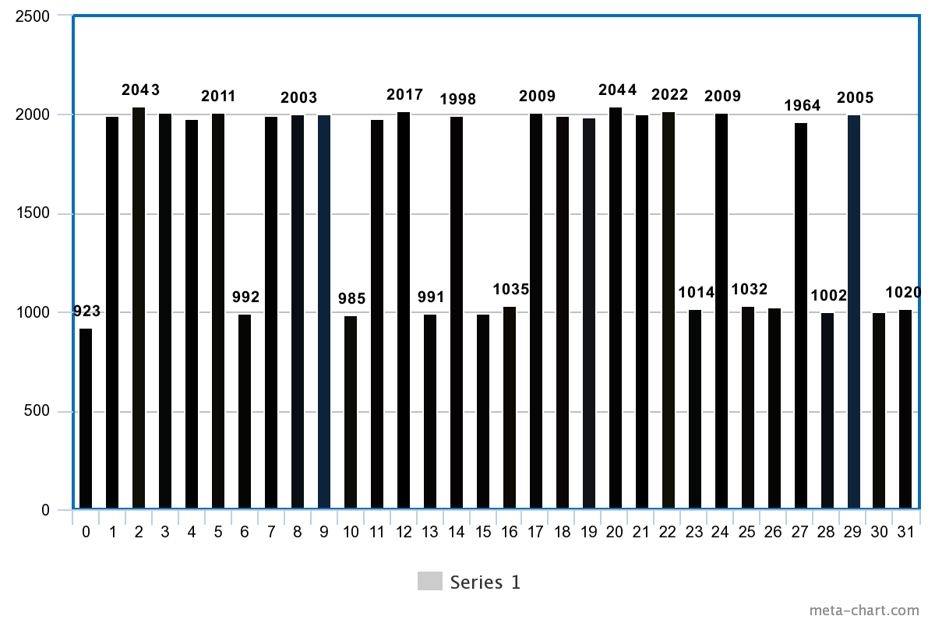
Ratios of 1s to 0s by column

Slide 6
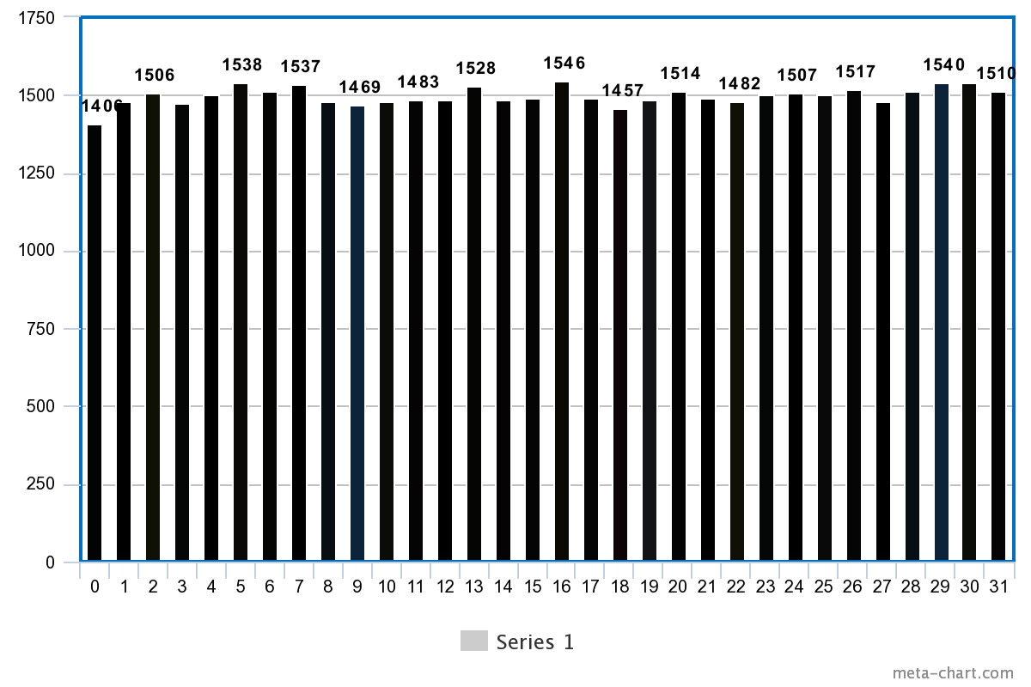
Ratios of 1s to 0s by column

Slide 7
Ratios of 1s to 0s by column
How do these results reflect on your algorithm?
Shows that the bits are right around where we would expect them to be
I’m interested in rerunning this on pairs of bits or whole bytes to see if there are any patterns

Slide 8
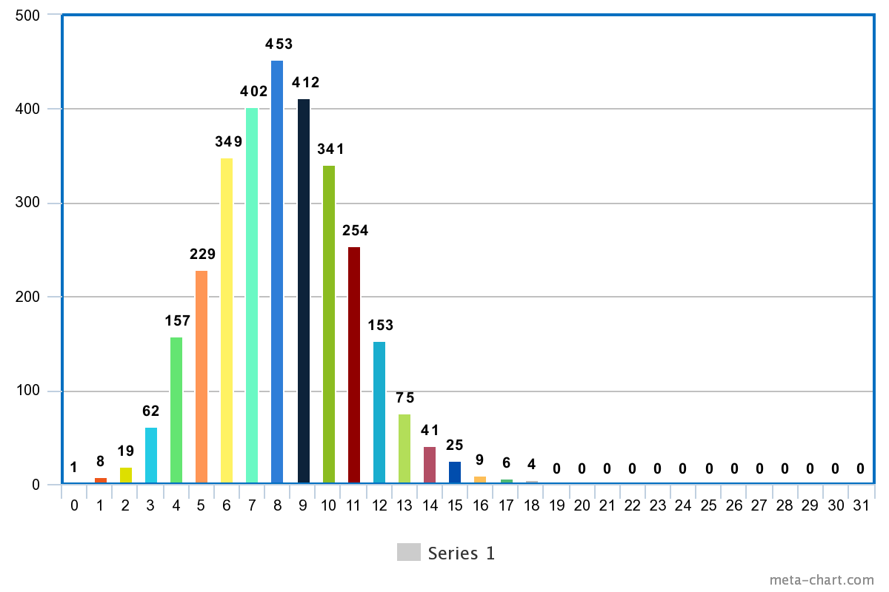
Matches between original and modified hashes

Slide 9
Matches between original and modified hashes
These results were the same for individual file types and for all added together.
This is an issue, it shows that there is a preimage making it through to the output of the hash
There are no obvious outliers, so that is a positive. The hash appears somewhat effective on all files.

Slide 10
Smhasher Results
HashStats Results
Tests Passed:
Keyset 'Cyclic' Tests
Keyset 'Combination Lowbits' Tests
Keyset 'Combination 0x0000001' Tests
Tests Failed:
The other 11
Window keyset is especially interesting
No collisions!
(But there are some collisions from this command

Slide 11
Conclusions
Is it collision resistant?
No! Smhasher found many collisions.
Is it preimage resistant?
Absolutely not, huge skew towards the left
If you had more time, how would you improve it?
More permutations in the shuffle function
Was the project interesting?
Very

